Slide 1
DATA SCIENCE PROJECT

Slide 2
Project overview:
In here we are going to learn a lot about various languages and their development. Their contribution to the world and to it’s greater good.
The survey which shows about the evolution of the technology gives us a brief explanation that drastically improving of requirements of database overview systems .

Slide 3
Intro:
Our main agenda is to understand and get aware of importance of database analysis .
The crucial role which is played by development languages which are used to build an easy and understandable data overview analysis.

Slide 4
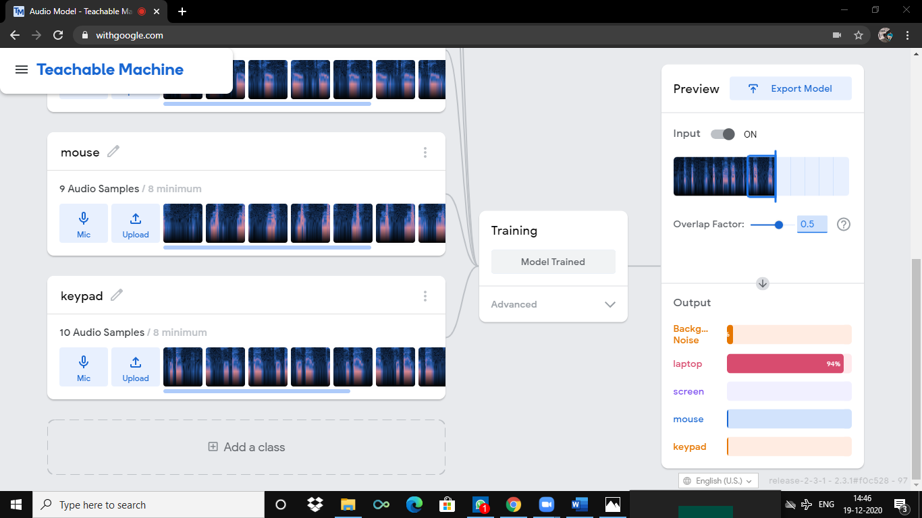
VARIOUS APPROACHES:
We know they are different ways to represent the data that we have. Many Ais have developed in the vast civilization.
Exploring to new technologies and methods is what we needed to achieve in data technology

Slide 5
Output:
Now a days representing of data is used widely because to avoid the confusion among comparisons and to improve effectiveness of map overview of information that have given.
We ought to give to view of any design or any project the database representation can be very helpful in a very analytical way.
Gathering the data about various fields that we work can make our life easier.

Slide 6
Eventuality:
Further examination of database studies . We can come to an end these ways of representation of data is very useful.
Studies that are done on this project give us many end lines such as evolution of technology and its importance.

